Slide 1


K.RAMAKRISHNAN COLLEGE OF TECHNOLOGY (AUTONOMOUS), TRICHY
FINDING AND REMOVING ENTRIES IN A DATASET
PRESENTED BY
RISHIYANTH S-2303811724321090

Slide 2
PRESENTATION OVERVIEW
Problem Identification
Objective
Proposed system
Block diagram of proposed system
R Libraries used
Modules of the system
Module Description
Advantages of Proposed system
Implementation
Output
Conclusion

Slide 3
PROBLEM IDENTIFICATION
Problem :When working with datasets, issues like duplicate records, missing values, incorrect data, or irrelevant entries can arise. These problems can lead to inaccurate analysis, poor decision-making, and biased machine learning models if not handled properly.
Solution:
Finding and Removing Duplicates
Handling Missing Values
Filtering Incorrect or Irrelevant Data
2/7/20

Slide 4
OBJECTIVE
The objective of finding and removing entries in a dataset is to ensure data accuracy, consistency, and reliability for effective analysis and decision-making.
Datasets often contain duplicate records, missing values, incorrect data, or irrelevant entries, which can lead to biased results, poor insights, and inefficiencies in data processing.
By identifying and eliminating such issues, organizations can improve data quality, optimize machine learning models, and enhance decision-making processes.

Slide 5
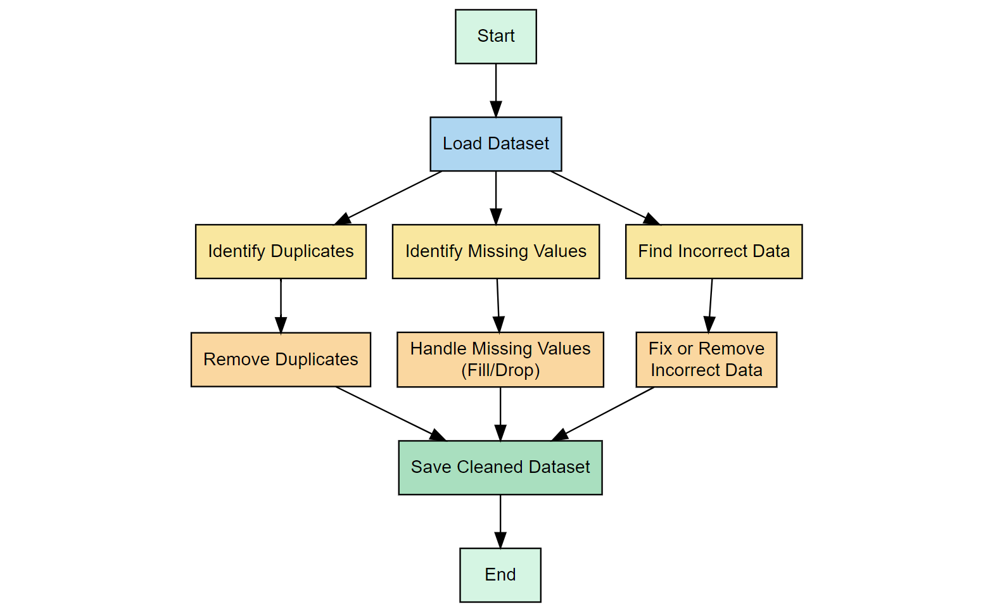
PROPOSED SYSTEM
BLOCK DIAGRAM

Slide 6
R LIBRARIES USED
The system will utilize various R Libraries:
shiny: Used to create interactive web applications directly from R.
DT: Used to display interactive data tables in the Shiny app.
dplyr : For data manipulation tasks like filtering, selecting, and removing duplicates in a more readable syntax.

Slide 7
MODULE OF THE SYSTEM
Modules used:
Data Collection and Import Module
Data Exploration and Preprocessing Module
Duplicate Detection Module
Duplicate Removal and Validation Module

Slide 8
MODULE DESCRIPTION
Data Collection and Import Module:This module gathers datasets from sources like CSV, Excel, or databases.
Data Exploration and Preprocessing Module:It analyzes the dataset’s structure, missing values, and inconsistencies. Preprocessing includes trimming,standardizing text and preparing for duplicate checks.
Duplicate Detection Module:This module identifies duplicates using function like duplicate() and string similarity.
Duplicate Removal and Validation Module: It removes or merges duplicates while preserving important information.

Slide 9
ADVANTAGES OF PROPOSED SYSTEM
Improved Data Quality : Eliminates redundant information, ensuring accuracy and consistency.
Efficient Processing : Optimized methods in R allow quick identification and removal of duplicates.
Scalability : Can handle large datasets efficiently with minimal computational overhead.
Customizable Rules : Users can define their own criteria for detecting and resolving duplicates.
Enhanced Analytical Accuracy : With clean data, analytical models and reports will be more reliable and insightful.

Slide 10
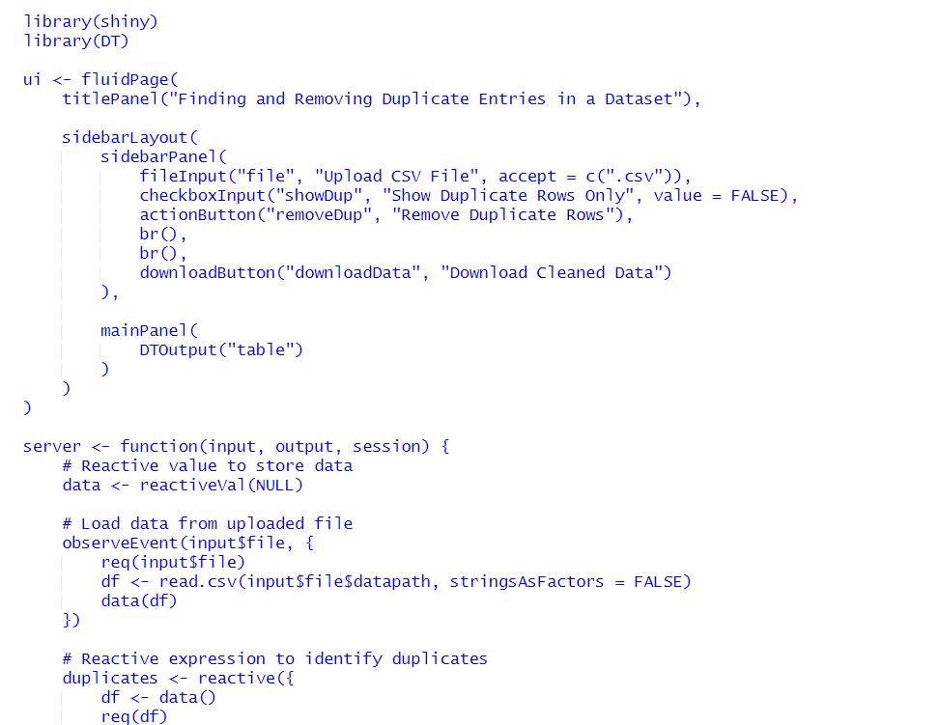
IMPLEMENTATION

Slide 11
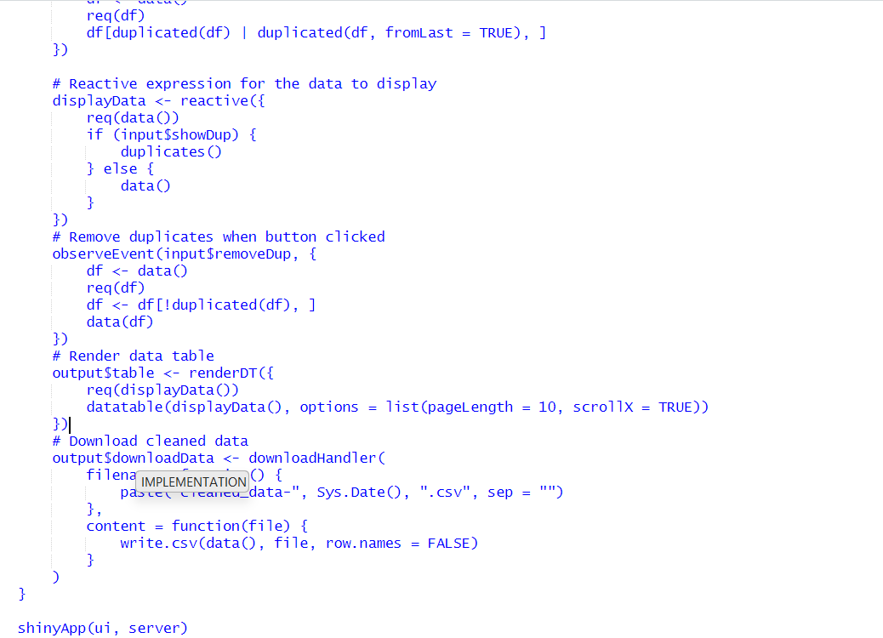
IMPLEMENTATION

Slide 12
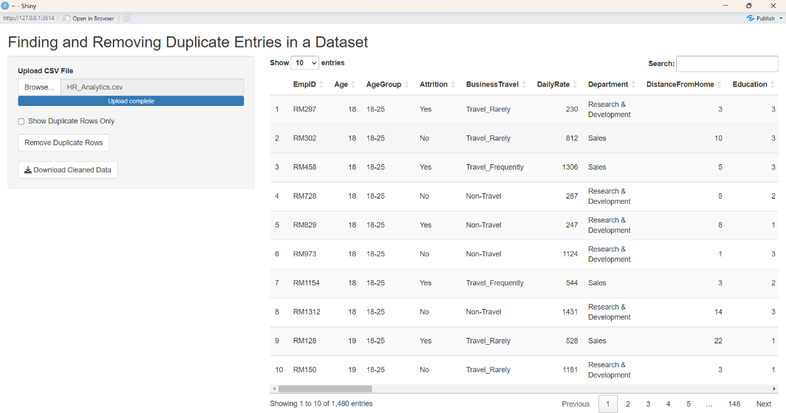
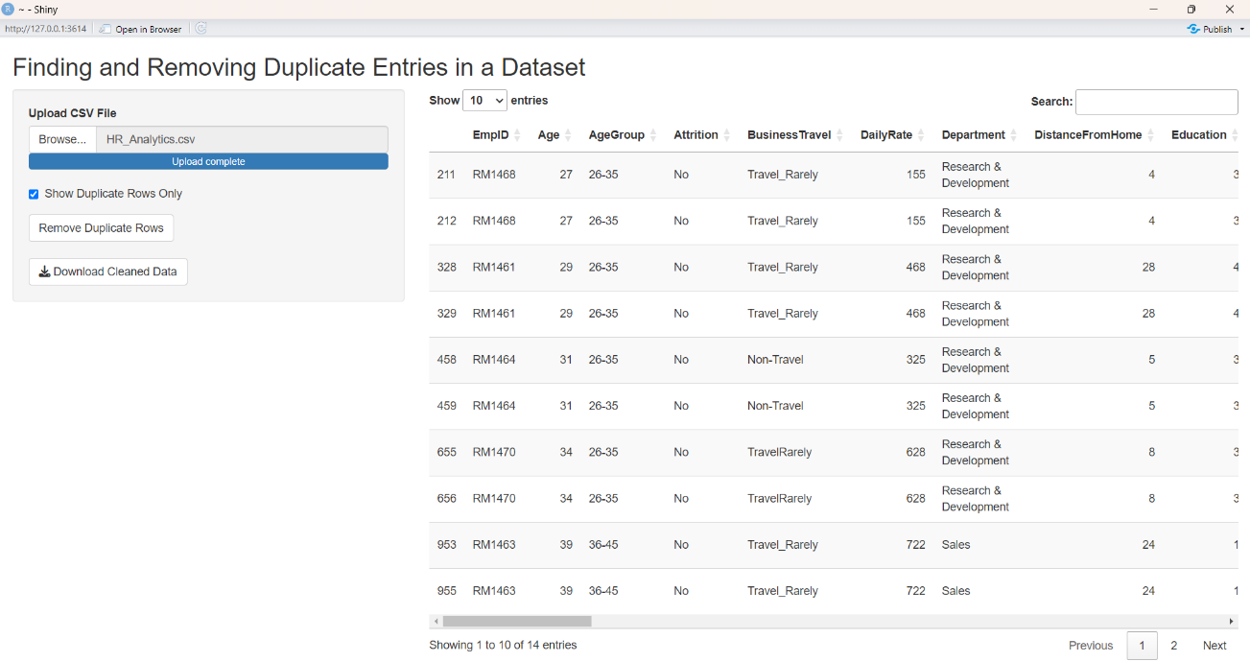
OUTPUT

Slide 13
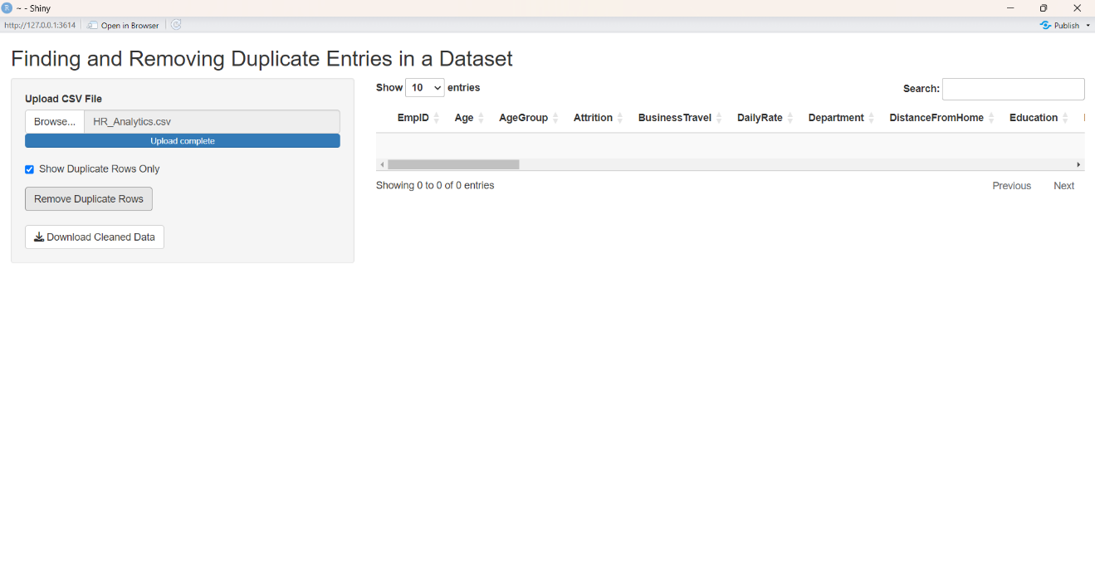
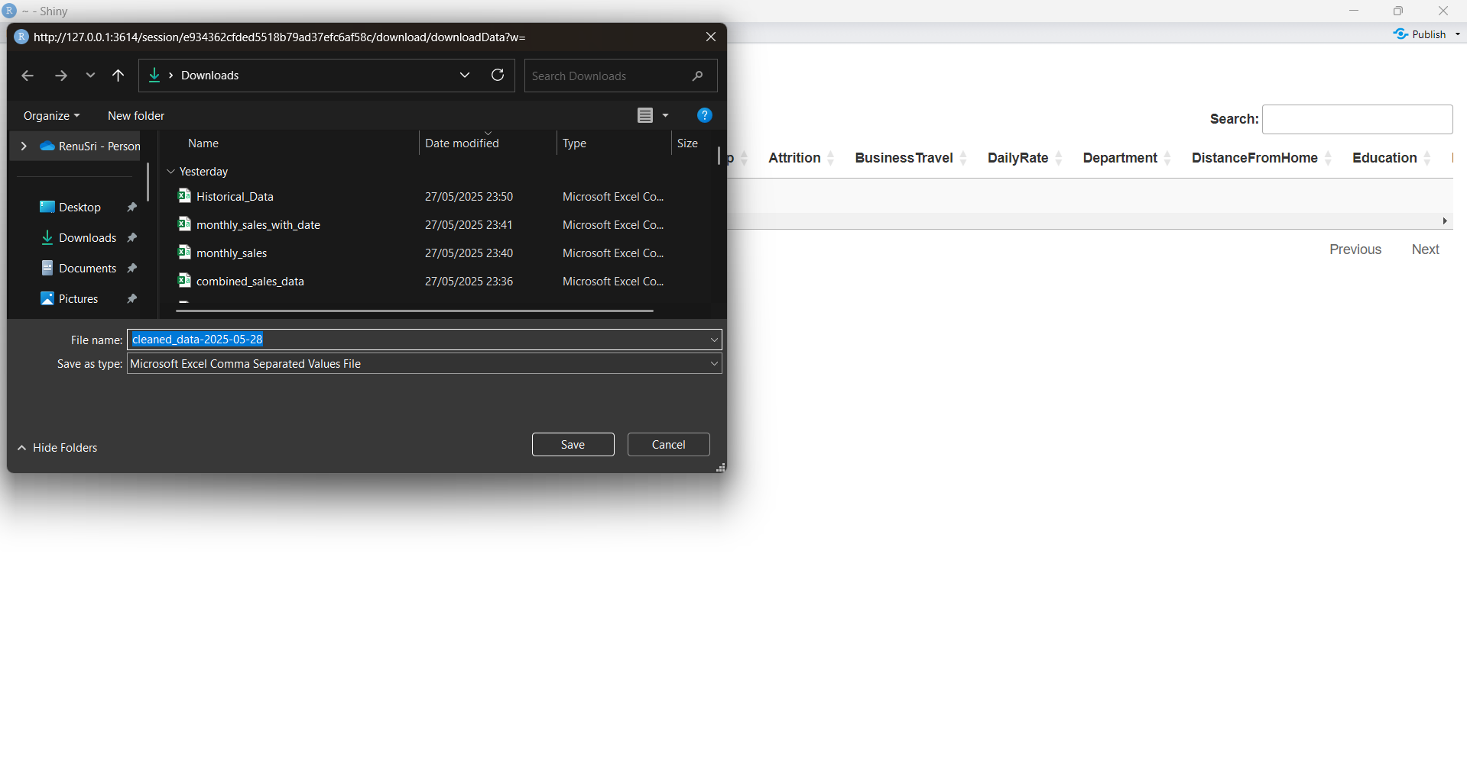
OUTPUT

Slide 14
CONCLUSION
The presence of duplicate entries in datasets can significantly impact the accuracy and reliability of data analysis and decision-making.
This project demonstrated effective methods for identifying and removing both exact and near-duplicate records using programming tools and data cleaning techniques.
By applying these methods, data quality is enhanced, redundancy is minimized, and storage efficiency is improved.
The cleaned and validated dataset provides a more trustworthy foundation for further analysis, reporting, and business intelligence.

Slide 15


